Slide 1
Get Real for Parents
A mobile website that puts the Get Real Middle School
Family Letters and Activities online!

Slide 2
Get to Know Get Real for Parents
The Get Real Middle School curriculum comes with access to the Get Real for Parents mobile website.
Parents and other caring adults can access the mobile website through their phone, tablet, or computer.
Get Real for Parents allows parents and other caring adults to complete the family activities on the website with their children, as well as access additional resources including answers to FAQs and Tips for Talking.
All educators will need a unique access code to provide to parents and other caring adults.

Slide 3
Get Real for Parents Evaluation
The Get Real for Parents mobile website was piloted in 1 Spanish- speaking school in MA with 25 students and included teen focus groups and interviews with parents and other caring adults.
Then, 8 schools in Colorado, Massachusetts, and Virginia participated in the formative evaluation of Get Real for Parents, led by Wellesley Centers for Women.
163 parents and caring adults participated, along with their children. After filing necessary consent forms, parents and their kids completed lesson activities along with pre-, mid-, and post-surveys regarding their experience using the website as well as comfort and frequency of conversations about communication, relationships, and sex.

Slide 4
Get Real for Parents Evaluation Results
We already know that involving parents and other caring adults as the primary sexuality educators of their own children has a positive impact. Now Get Real for Parents makes it even easier!
Both parents AND teens (boys and girls) reported significantly more talk with one another about relationships and sexuality after engaging with the Get Real for Parents activities than before participating in the program.
Parents and teens reported that activities and conversation starters in Get Real for Parents helped teens and parents bring up new conversations and questions, even after they had completed the lessons and activities.

Slide 5
Accessing Get Real for Parents
In order for you to support the parents and caring adults of your students, the following slides will show you exactly what parents and caring adults will see when they log in to complete the activities with their children.
Take a look so that you can field questions from parents as they begin engaging with the website.
After a look at the website, there will be a few slides about how you, the Get Real Educator, can support parents and caring adults in using the website.

Slide 6
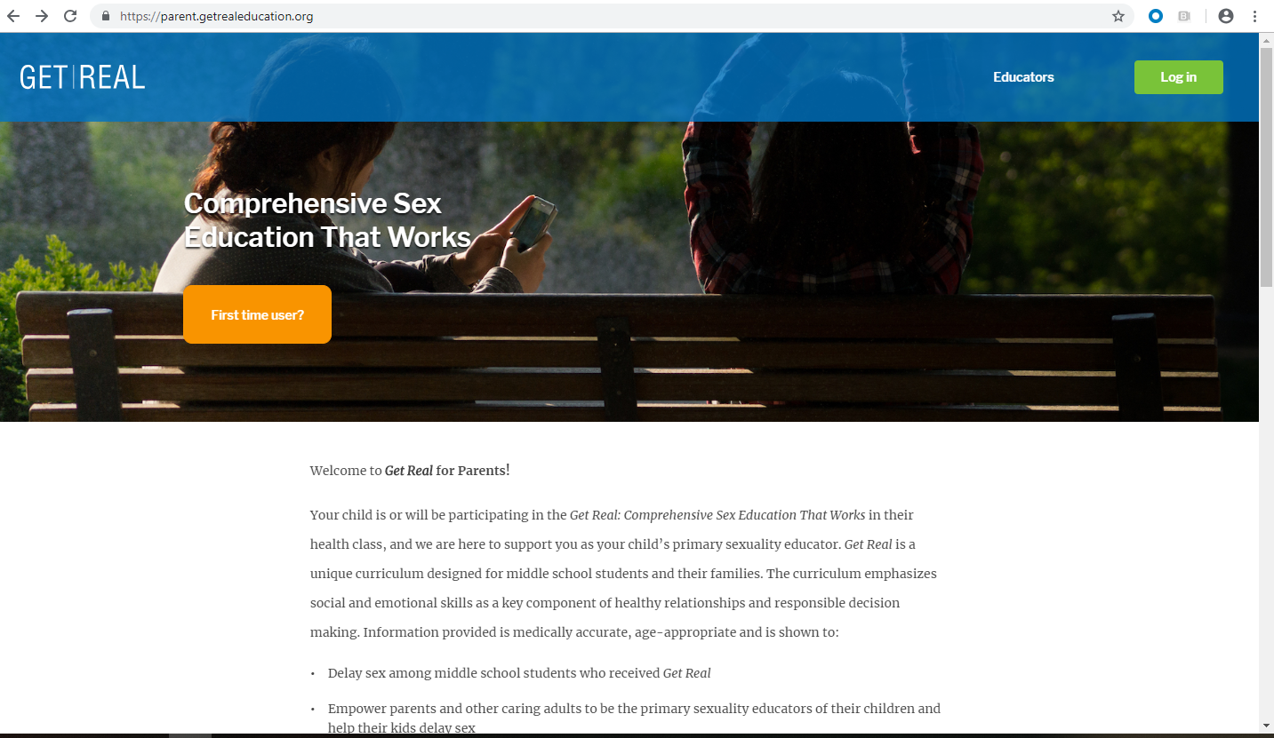
Parents and caring adults will go to: parent.getrealeducation.org.
They will click on the orange “First time user?” button.

Slide 7
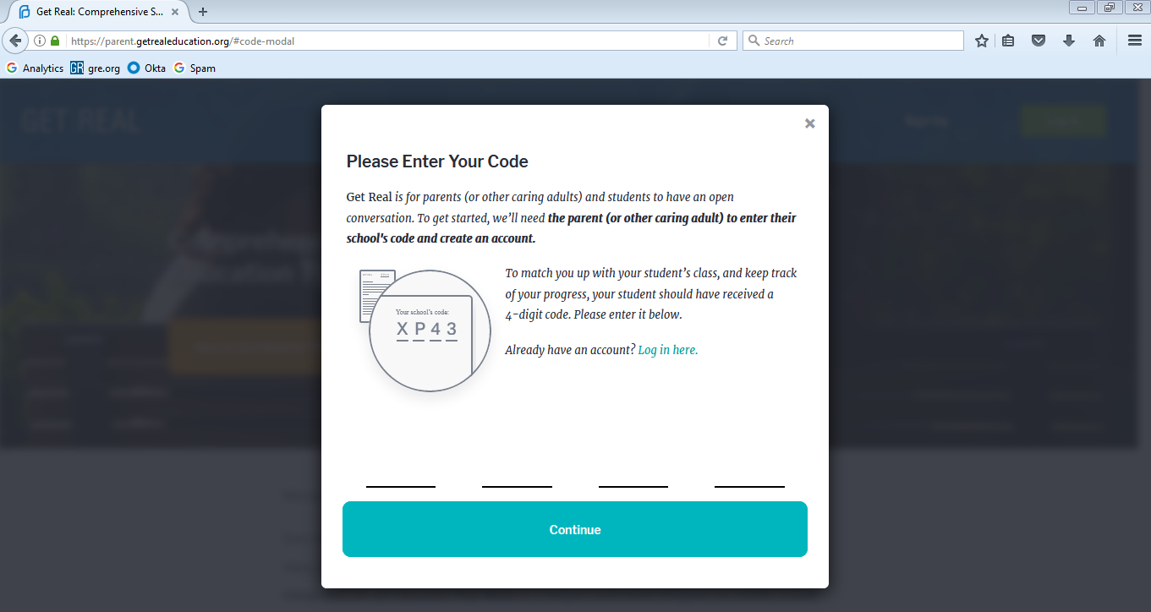
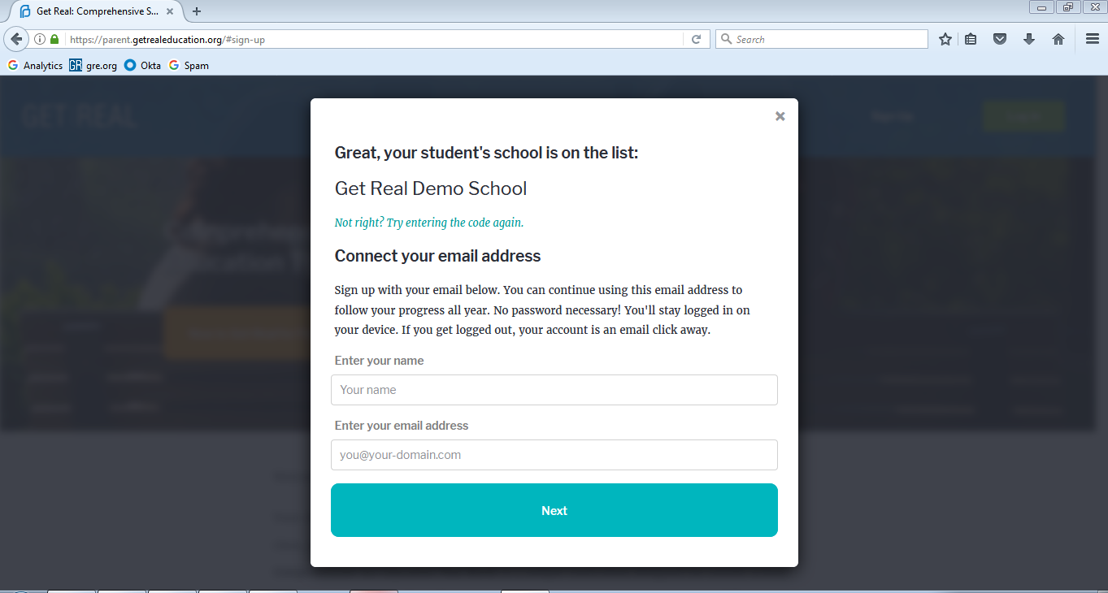
Parents and caring adults will enter the unique educator access code that you provide to them.
On the next screen, they will enter their name and email address.

Slide 8
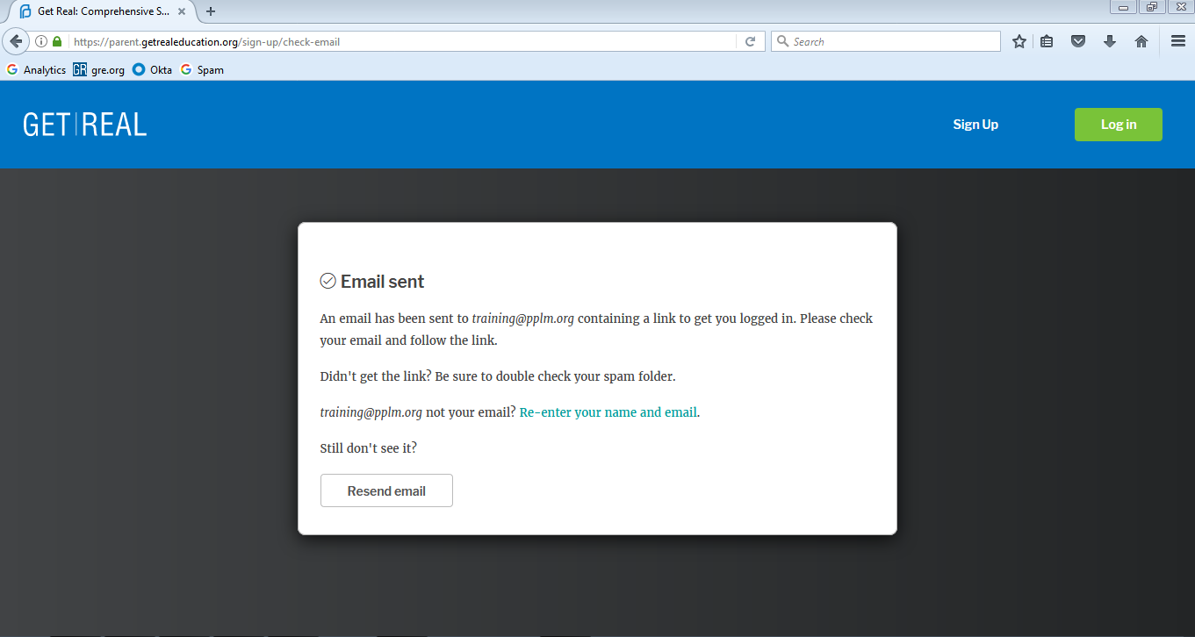
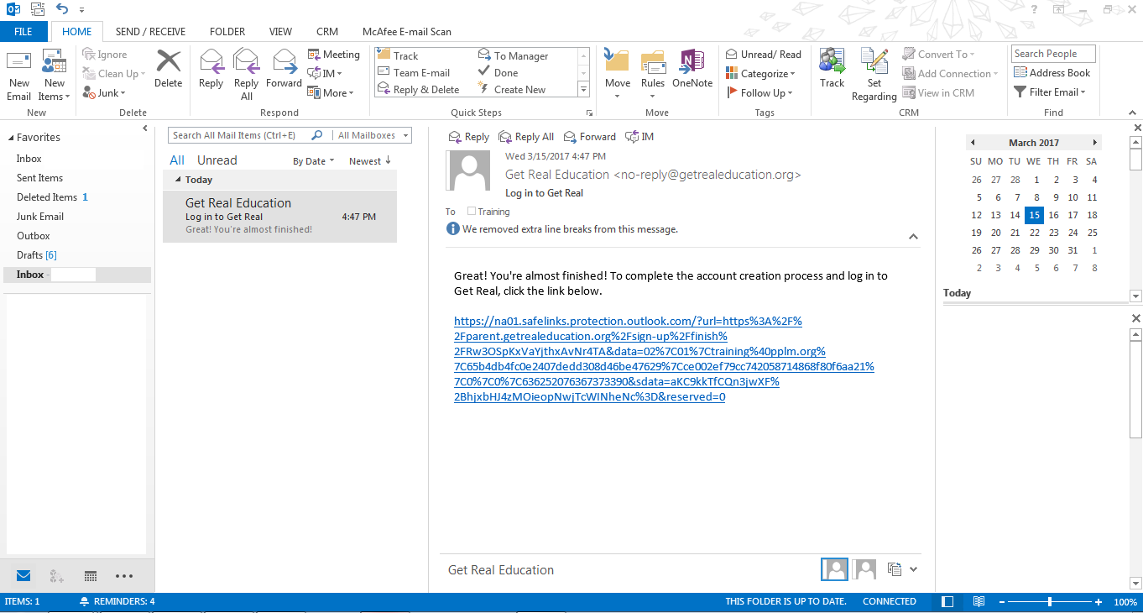
After inputting their information, they will check the inbox of the email they just entered for a login link. They will click on the link to complete login.

Slide 9
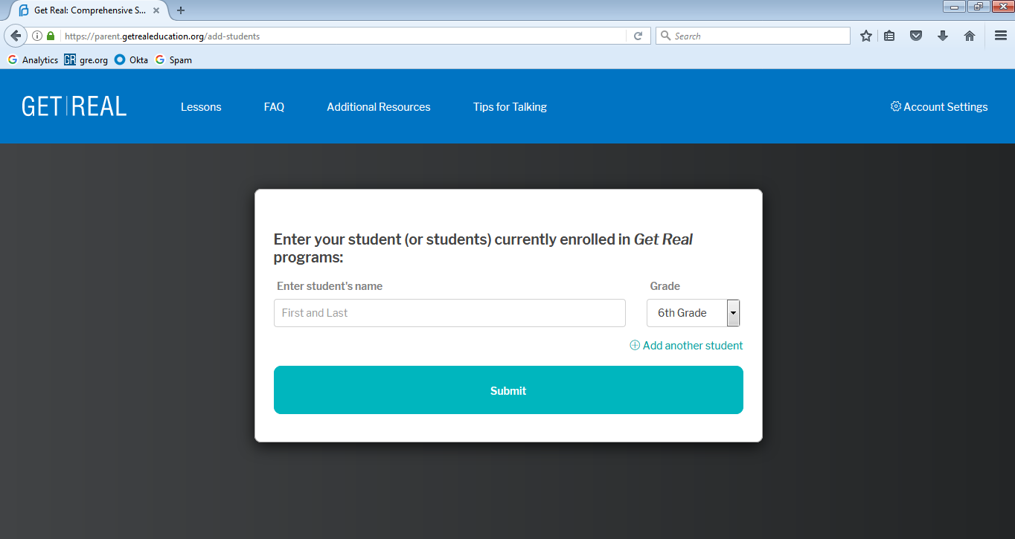
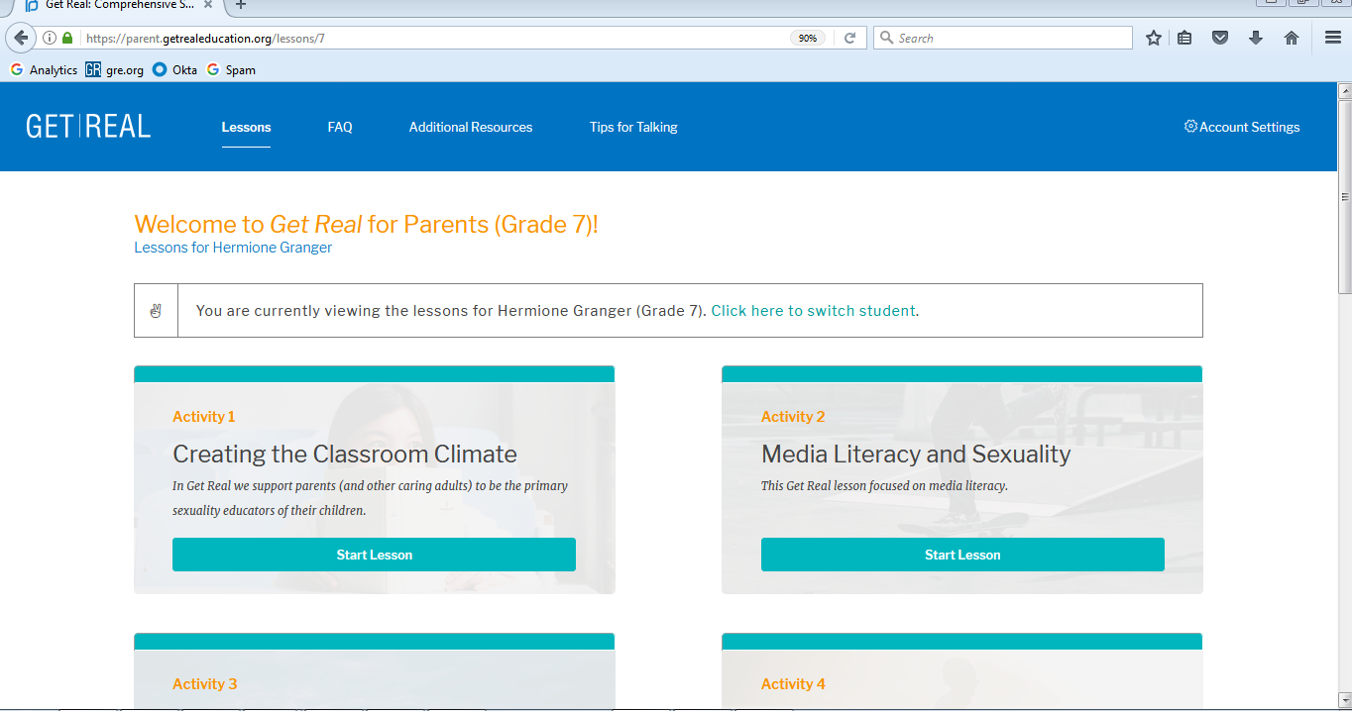
After clicking the link, they will be brought back to the Get Real for Parents website where they will enter their child’s name and grade level.
After submitting their child’s information, they will be on the website! This is an example of the “Dashboard” page that they will see for their child.

Slide 10
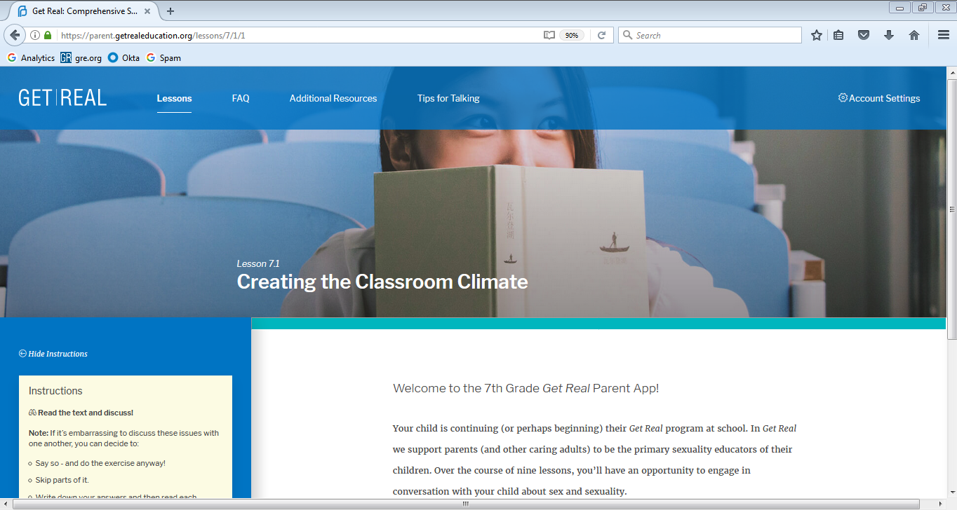
Inside Get Real for Parents
This screen is an example of what one of the lessons looks like. A parent or caring adult can click on “lessons” to return to their dashboard to complete another lesson, switch students, or switch grades.

Slide 11
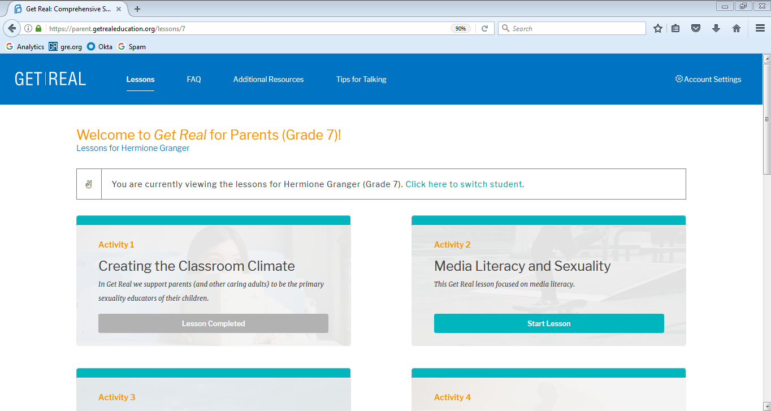
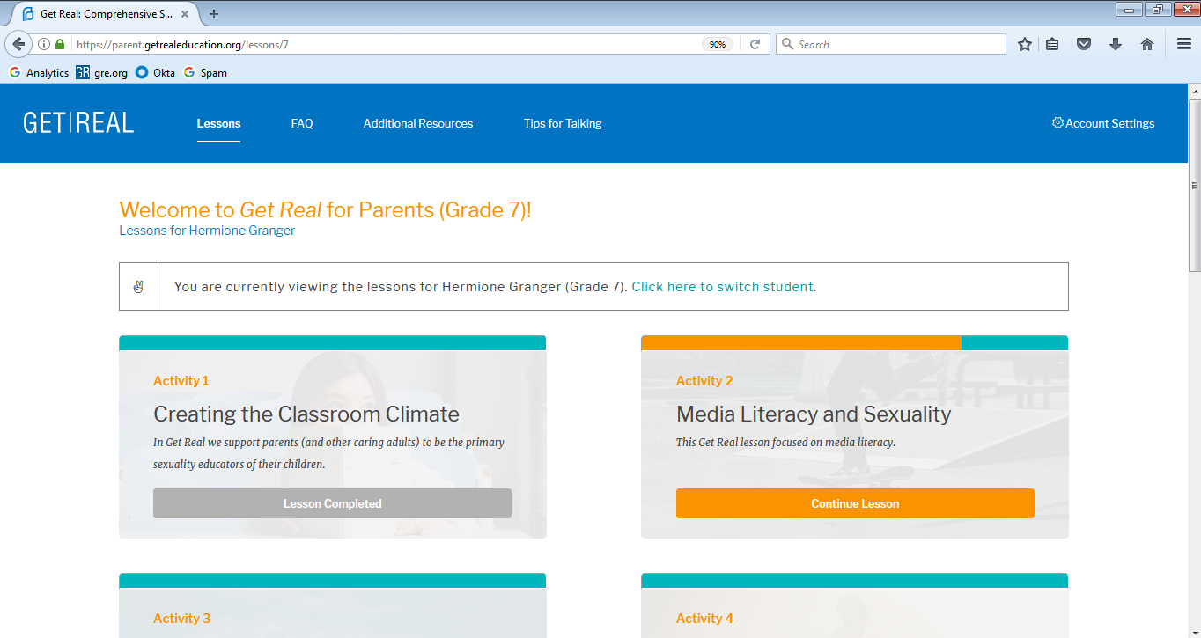
When a lesson is in-progress or complete, the dashboard will reflect this with a grayed-out or orange-colored progress bar.

Slide 12
Parents/caring adults have access to several great resources including frequently asked questions from young people with recommended answers; additional resource referrals; and tips for having conversations with young people about love, relationships, and sex.

Slide 13
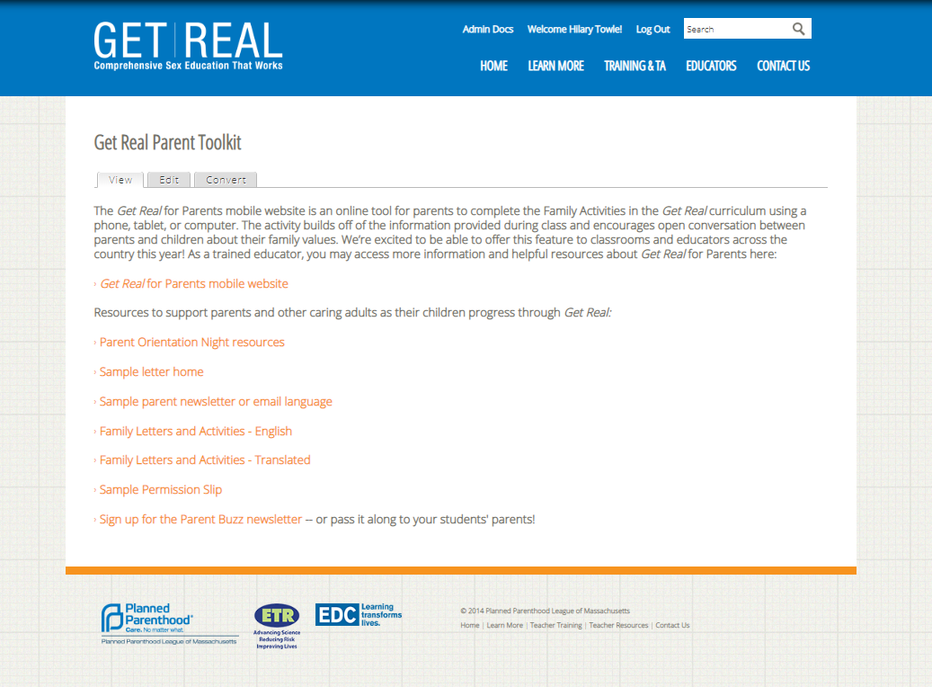
Supporting Parents and Caring Adults
We have provided a number of resources to support you in supporting the parents and caring adults of your students. These can be found in the Parent Toolkit on getrealeducation.org.

Slide 14
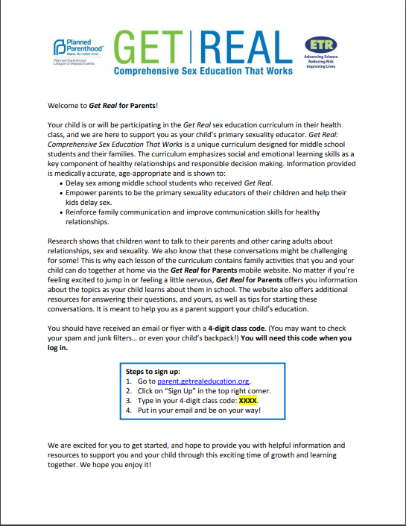
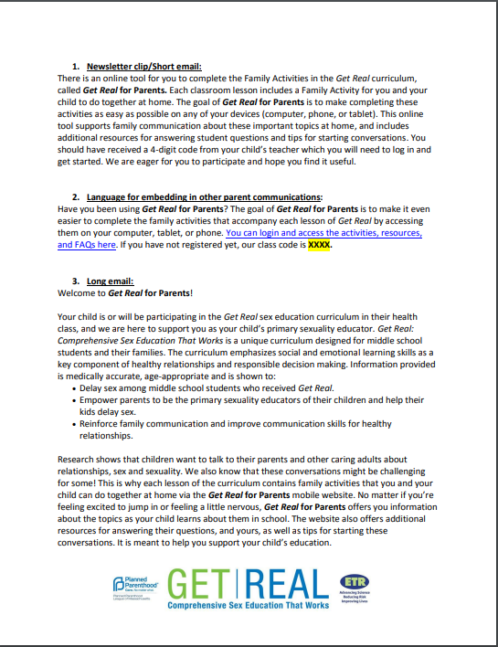
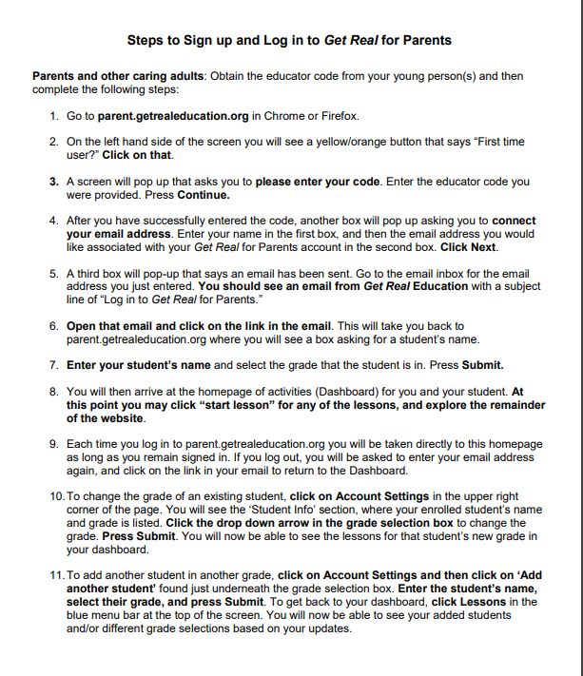
Supporting Parents and Caring Adults
There is a sample introduction letter to send home to parents, some sample language for a class or school newsletter, and steps for logging in that you can send home to parents.

Slide 15
Wrapping Up
In this presentation, we have…
Introduced the purpose of the Get Real for Parents mobile website.
Presented evaluation results supporting the website’s efficacy.
Reviewed how parents and caring adults access the website and create a dashboard for their child.
Showcased all of the tools you as the educator have at your disposal for encouraging the parents and caring adults of your students to use the website.
Simply email training@pplm.org to receive your educator access code and get parents and caring adults started!

